Slide 1
Refining
Data
Real-Time Trend Analysis Pipeline for Spotify
Gathering
Data
Exploratory
Data
Analysis
Data
Modelling
Deployment
Model
Evaluation

Slide 2
About Us
Refining
Data
Real-Time Trend Analysis Pipeline for Spotify
Gathering
Data
Exploratory
Data
Analysis
Data
Modelling
Deployment
Model
Evaluation

Slide 3







About Us
Chanakya Samsani
Business Analyst
Bikram Chand
Data Engineer
Sai Charan Chandu
DevOps Engineer
Chethan Chakradhar
ML Engineer

Slide 4




Project Objective
About Us
Develop a scalable and robust data engineering pipeline for real-time trend analysis of Spotify streaming data.
Develop a
scalable and robust data
engineering pipeline
for real-time
trend analysis
of Spotify
streaming data
Chanakya Samsani
Business Analyst
Bikram Chand
Data Engineer
Sai Charan Chandu
DevOps Engineer
Chethan Chakradhar
ML Engineer

Slide 5




About Us
Business Questions
Project Objective
What are the steps are being taken to protect business data and ensure cyber security?
What are the emerging trends in business and how can we capitalize on them?
Develop a
scalable and robust data
engineering pipeline
for real-time
trend analysis
of Spotify
streaming data
Chanakya Samsani
Business Analyst
Bikram Chand
Data Engineer
Sai Charan Chandu
DevOps Engineer
Chethan Chakradhar
ML Engineer

Slide 6





Project Objective
Develop a
scalable and robust data
engineering pipeline
for real-time
trend analysis
of Spotify
streaming data
Proposed Solutions
Business Questions
What are the steps are being taken to protect business data and ensure cyber security?
What are the emerging trends in business and how can we capitalize on them?
We secure data through encryption, multi-factor authentication, and ongoing monitoring, ensuring a resilient cybersecurity framework.
Personalized content, AI driven recommendations and interactive user experiences are top emerging trends that we can capitalize to improve business

Slide 7


Business Questions
What are the steps are being taken to protect business data and ensure cyber security?
What are the emerging trends in business and how can we capitalize on them?
Our Approaches
Proposed Solutions
We secure data through encryption, multi-factor authentication, and ongoing monitoring, ensuring a resilient cybersecurity framework.
Personalized content, AI driven recommendations and interactive user experiences are top emerging trends that we can capitalize to improve business

Slide 8
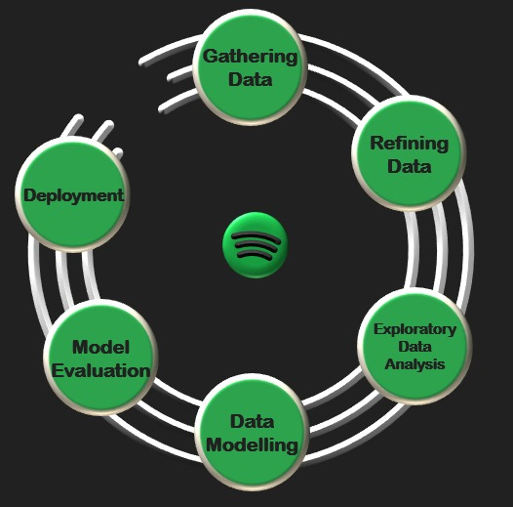


Proposed Solutions
We secure data through encryption, multi-factor authentication, and ongoing monitoring, ensuring a resilient cybersecurity framework.
Personalized content, AI driven recommendations and interactive user experiences are top emerging trends that we can capitalize to improve business
Our Approaches
THIS IS CRISP - DM
THIS IS Data Pipeline
THIS IS CRISP – DM
Dismiss

Slide 9

Our Approaches
THIS IS CRISP – DM
Dismiss
THIS IS CRISP - DM
THIS IS Data Pipeline
THIS IS Data Pipeline
Dismiss

Slide 10
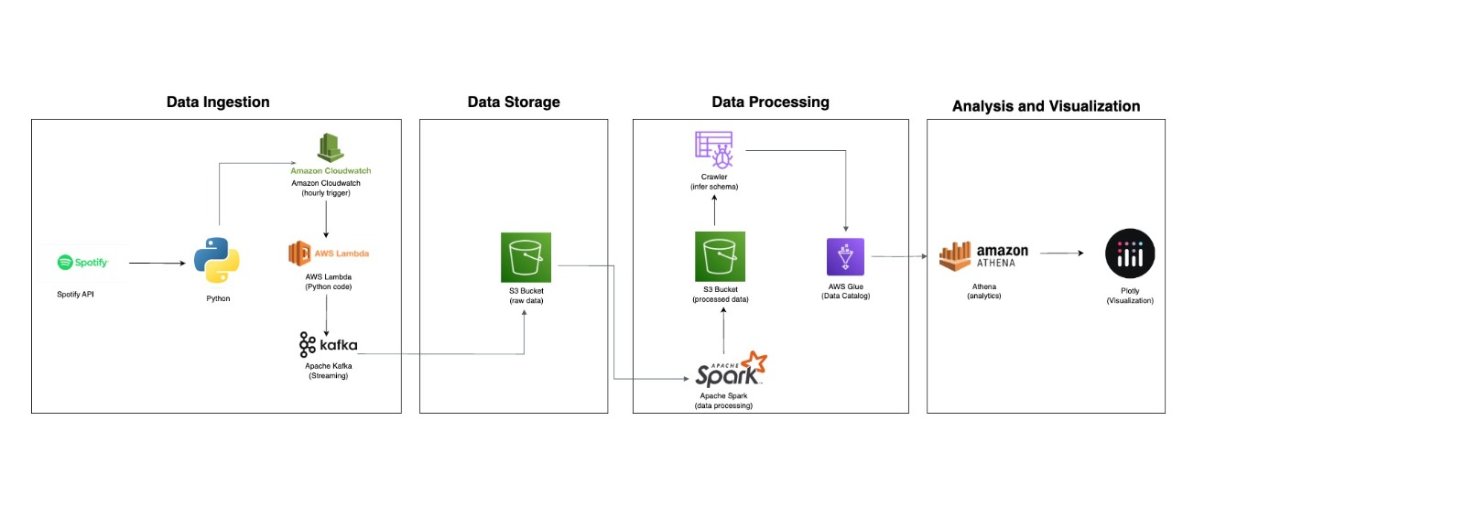
Data Pipeline
Our Approaches
THIS IS Data Pipeline
Dismiss
THIS IS CRISP - DM
THIS IS Data Pipeline
THIS IS Data Pipeline
THIS IS CRISP – DM
Dismiss

Slide 11
Data Pipeline
Our Approaches
THIS IS CRISP - DM
THIS IS Data Pipeline
THIS IS Data Pipeline
THIS IS Data Pipeline
Dismiss
THIS IS CRISP – DM
Dismiss

Slide 12

Our Approaches
Data Pipeline
Spotify API accesses data about tracks such as title, artist, and popularity.
Python executes custom code to interact with the Spotify API and handle data.
Amazon CloudWatch triggers Python code to run hourly for regular data updates.
AWS Lambda runs Python functions to process track data efficiently.
Kafka streams or transmits track data in real-time for further processing.
S3 bucket stores the raw data retrieved from the Spotify API.
Apache Spark processes large volumes of track data quickly and effectively.
S3 bucket stores cleaned and preprocessed track data after Spark processing.
Crawler automatically infers the structure of the track data.
AWS Glue manages the data catalog, making it easy to query and analyze.
Athena runs SQL queries on the stored data for insightful analytics.
Plotly creates visualizations of analytics results from Athena queries for easier interpretation.
THIS IS Data Pipeline
THIS IS CRISP – DM
Dismiss
THIS IS Data Pipeline
Dismiss
THIS IS CRISP - DM
THIS IS Data Pipeline

Slide 13
Our Approaches
Spotify API accesses data about tracks such as title, artist, and popularity.
Python executes custom code to interact with the Spotify API and handle data.
Amazon CloudWatch triggers Python code to run hourly for regular data updates.
AWS Lambda runs Python functions to process track data efficiently.
Kafka streams or transmits track data in real-time for further processing.
S3 bucket stores the raw data retrieved from the Spotify API.
Apache Spark processes large volumes of track data quickly and effectively.
S3 bucket stores cleaned and preprocessed track data after Spark processing.
Crawler automatically infers the structure of the track data.
AWS Glue manages the data catalog, making it easy to query and analyze.
Athena runs SQL queries on the stored data for insightful analytics.
Plotly creates visualizations of analytics results from Athena queries for easier interpretation.
Data Pipeline
THIS IS Data Pipeline
THIS IS CRISP – DM
Dismiss
THIS IS Data Pipeline
Dismiss
THIS IS CRISP - DM
THIS IS Data Pipeline

Slide 14
Our Approaches
Spotify API accesses data about tracks such as title, artist, and popularity.
Python executes custom code to interact with the Spotify API and handle data.
Amazon CloudWatch triggers Python code to run hourly for regular data updates.
AWS Lambda runs Python functions to process track data efficiently.
Kafka streams or transmits track data in real-time for further processing.
S3 bucket stores the raw data retrieved from the Spotify API.
Apache Spark processes large volumes of track data quickly and effectively.
S3 bucket stores cleaned and preprocessed track data after Spark processing.
Crawler automatically infers the structure of the track data.
AWS Glue manages the data catalog, making it easy to query and analyze.
Athena runs SQL queries on the stored data for insightful analytics.
Plotly creates visualizations of analytics results from Athena queries for easier interpretation.
Data Pipeline
THIS IS Data Pipeline
THIS IS CRISP – DM
Dismiss
THIS IS Data Pipeline
Dismiss
THIS IS CRISP - DM
THIS IS Data Pipeline

Slide 15
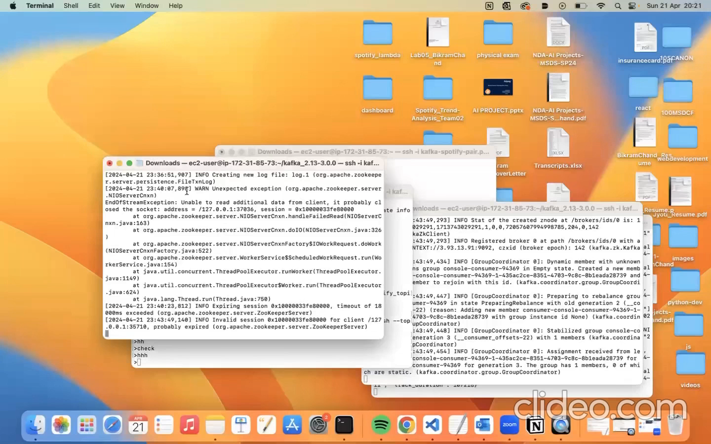
Our Approaches
Thank You
for
Listening!
Spotify API accesses data about tracks such as title, artist, and popularity.
Python executes custom code to interact with the Spotify API and handle data.
Amazon CloudWatch triggers Python code to run hourly for regular data updates.
AWS Lambda runs Python functions to process track data efficiently.
Kafka streams or transmits track data in real-time for further processing.
S3 bucket stores the raw data retrieved from the Spotify API.
Apache Spark processes large volumes of track data quickly and effectively.
S3 bucket stores cleaned and preprocessed track data after Spark processing.
Crawler automatically infers the structure of the track data.
AWS Glue manages the data catalog, making it easy to query and analyze.
Athena runs SQL queries on the stored data for insightful analytics.
Plotly creates visualizations of analytics results from Athena queries for easier interpretation.
Data Pipeline
THIS IS Data Pipeline
THIS IS CRISP – DM
Dismiss
THIS IS Data Pipeline
Dismiss
THIS IS CRISP - DM
THIS IS Data Pipeline

Slide 16
Our Approaches
Thank You
for
Listening!
Spotify API accesses data about tracks such as title, artist, and popularity.
Python executes custom code to interact with the Spotify API and handle data.
Amazon CloudWatch triggers Python code to run hourly for regular data updates.
AWS Lambda runs Python functions to process track data efficiently.
Kafka streams or transmits track data in real-time for further processing.
S3 bucket stores the raw data retrieved from the Spotify API.
Apache Spark processes large volumes of track data quickly and effectively.
S3 bucket stores cleaned and preprocessed track data after Spark processing.
Crawler automatically infers the structure of the track data.
AWS Glue manages the data catalog, making it easy to query and analyze.
Athena runs SQL queries on the stored data for insightful analytics.
Plotly creates visualizations of analytics results from Athena queries for easier interpretation.
THIS IS CRISP – DM
Dismiss
Data Pipeline
THIS IS Data Pipeline
Dismiss
THIS IS CRISP - DM
THIS IS Data Pipeline
THIS IS Data Pipeline

